Slide 1

2 chronicles 35:1 – 36:23
A CD of this message will be available (free of charge immediately following today's message
This message will be available via podcast later this week at calvaryokc.com

Slide 2
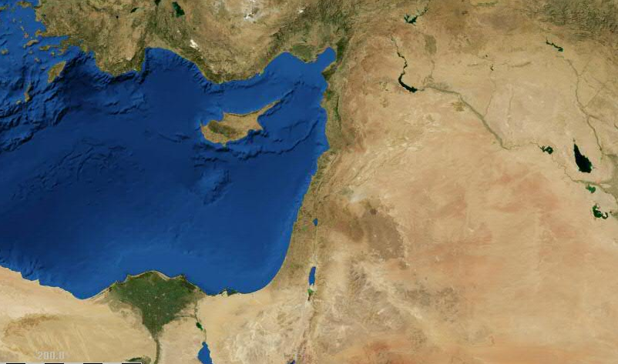
2 chronicles 35:1 – 36:23
Carchemish
Nineveh
Haran
Pharaoh Necho
King Josiah
Megiddo

Slide 3
2 chronicles 35:1 – 36:23
David Y
1010-970BC
Solomon Y
970-930BC
Jehoram
847-840BC
Amaziah
796-768BC
Hezekiah
715-686BC
Asa
911-871BC
Queen Athaliah
840-835BC
Jotham
739-735BC
Amon
642-640BC
1000 BC
950 BC
900 BC
850 BC
800 BC
750 BC
700 BC
650 BC
600 BC
550 BC
500 BC
Rehoboam
930-914BC
Jehoshaphat
871-847BC
Joash
835-796BC
Ahaz
735-715BC
Josiah
640-609BC
Abijam
914-911BC
Azariah
840BC
Uzziah
768-739BC
Manasseh
686-642BC
Y | Ruled over united kingdom
Note: Some dates are approximate. Reigns do not include co-regencies
Kings of
Judah

Slide 4
2 chronicles 35:1 – 36:23
Jehoahaz
609 BC
Jehoiakim
608-598BC
Jehoiachin
597BC
Zedekiah
597-586BC
610 BC
605 BC
600 BC
595 BC
590 BC
585 BC
580 BC
575 BC
570 BC
565 BC
560 BC
1st Deportation
605 BC
2nd Deportation
597 BC
3rd Deportation
586 BC
The last days
Of Judah

Slide 5
2 chronicles 35:1 – 36:23
Eze. 12:13 ~ I will also spread My net over him, and he shall be caught in My snare. I will bring him to Babylon, to the land of the Chaldeans; yet he shall not see it, though he shall die there.
Jer. 39:6-7 ~ ⁶ Then the king of Babylon killed the sons of Zedekiah before his eyes in Riblah; the king of Babylon also killed all the nobles of Judah. ⁷ Moreover he put out Zedekiah’s eyes, and bound him with bronze fetters to carry him off to Babylon.

Slide 6
2 chronicles 35:1 – 36:23
Is. 45:1-3 ~ ¹ Thus says the LORD to His anointed,
To Cyrus, whose right hand I have held—
To subdue nations before him
And loose the armor of kings,
To open before him the double doors,
So that the gates will not be shut:
² "I will go before you
And make the crooked places straight;
Is. 44:28 ~ Who says of Cyrus, ‘He is My shepherd, And he shall perform all My pleasure, Saying to Jerusalem, "You shall be built," And to the temple, "Your foundation shall be laid."’
I will break in pieces the gates of bronze
And cut the bars of iron.
³ I will give you the treasures of darkness
And hidden riches of secret places,
That you may know that I, the LORD,
Who call you by your name,
Am the God of Israel.”
Isaiah prophesied around 725 BC
Cyrus came to the throne in 539 BC

